Slide 1
ELEMENTARY STATISTICS, BLUMAN
Quartiles, Boxplot, and Outliers
© 2019 McGraw-Hill Education. All rights reserved. Authorized only for instructor use in the classroom. No reproduction or further distribution permitted without the prior written consent of McGraw-Hill Education.

Slide 2
Objectives for this PowerPoint
The objective for this video is to learn how to construct a Boxplot and how to determine Outliers in a data set.

Slide 3
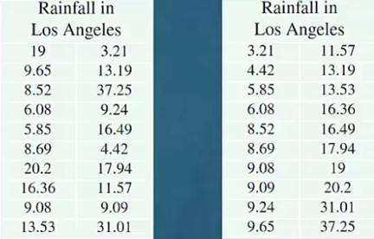
Los Angeles Rainfall Data
In a previous PowerPoint we constructed the Five Number Summary for the July 1 to June 30 annual rainfall in Los Angeles for the years 1997 to 1998 through 2016 to 2017.

Slide 4
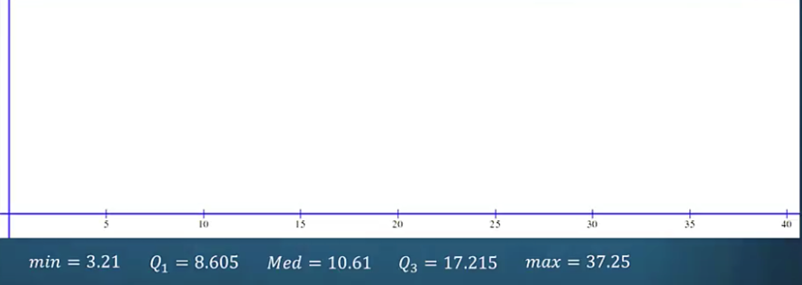
Example (1)
The Five Number Summary can be used to construct a graph called a boxplot. It is important that the boxplot is scaled on a horizontal axis. Here is a horizontal axis that is scaled from 0 to 40. This will be a convenient scale since our minimum value is 3.21 and our maximum value is 37.25.

Slide 5
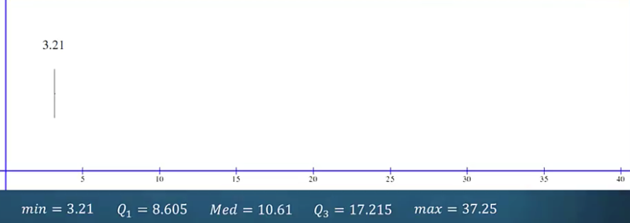
Example (2)
We will begin by drawing a vertical line above the horizontal axis at the minimum value 3.21 and label it.

Slide 6
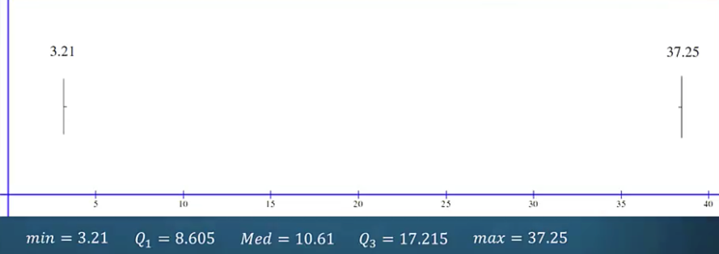
Example (3)
Next we will draw another vertical line above the horizontal axis at the maximum value of 37.25 and label that also.

Slide 7
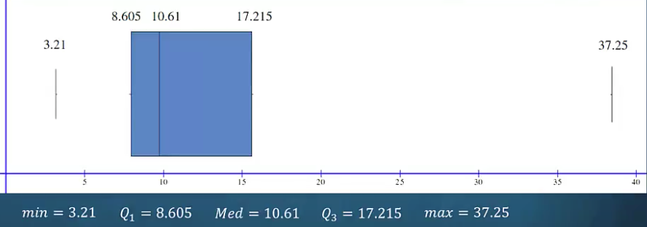
Example (4)
Now we will draw a box with vertical lines that set the outer boundaries at the first quartile of 8.605 and the third quartile of 17.215. This box will also have a vertical line that marks the median value of 10.61.

Slide 8
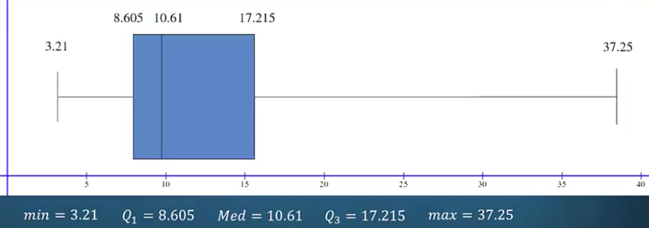
Example (5)
The box plot is completed by drawing a horizontal line that extends from the minimum value to the center of the box and a similar horizontal line that extends to the maximum value.
The boxplot shows us the distribution of the data values with regard to the quartiles.

Slide 9

Example (6)
We can see that 50% of the data values appear to be clustered in a short span from the minimum value of 3.21 to the median of 10.61. We can likewise see that the upper 25% of the data set appears to have a wide spread as the box plot shows by the length of the horizontal line that connects the third quartile and the maximum data value.

Slide 10

Outliers (1)
Sometimes a data set might contain what is called an outlier. An outlier is an extremely high or extremely low data value when compared to the rest of the data values. One method for finding outliers in a data set utilizes a measure called the interquartile range which is frequently abbreviated IQR.
The interquartile range is the difference between the first and third quartiles. Substituting these values we find that the interquartile range for this data set is 8.61.
$$IQR=Q_{3}−Q_{1}=17.215−8.605=8.61$$

Slide 11

Outliers (2)
We will evaluate two formulas.
The first is the first quartile minus one and a half times the interquartile range and the second is the third quartile plus one and a half times the interquartile range.
$$Q_{1}−1.5∗IQR$$
$$Q_{3}+1.5∗IQR$$
These two formulas provide us with left and right endpoints for an interval. Data values that lie outside of this interval we will consider to be outliers in the data set.

Slide 12

Outliers (3)
Substituting in the first formula we find a left endpoint of -4.31. Substituting into the second formula we find a right endpoint of 30.13.
$$Q_{1}−1.5∗IQR=8.605−1.5∗8.61=−4.31$$
$$Q_{3}+1.5∗IQR=17.215+1.5∗8.61=30.13$$

Slide 13
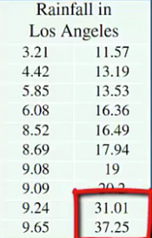
Outliers (4)
We can see from the ordered data set that the values 31.01 and 37.25 lie outside of this interval.
We will consider 31.01 and 37.25 inches of rain to be outliers.

Slide 14
Summary
In this PowerPoint we learned how to construct a Boxplot for a set of data and how to determine Outliers in a data set.

